Slide 1

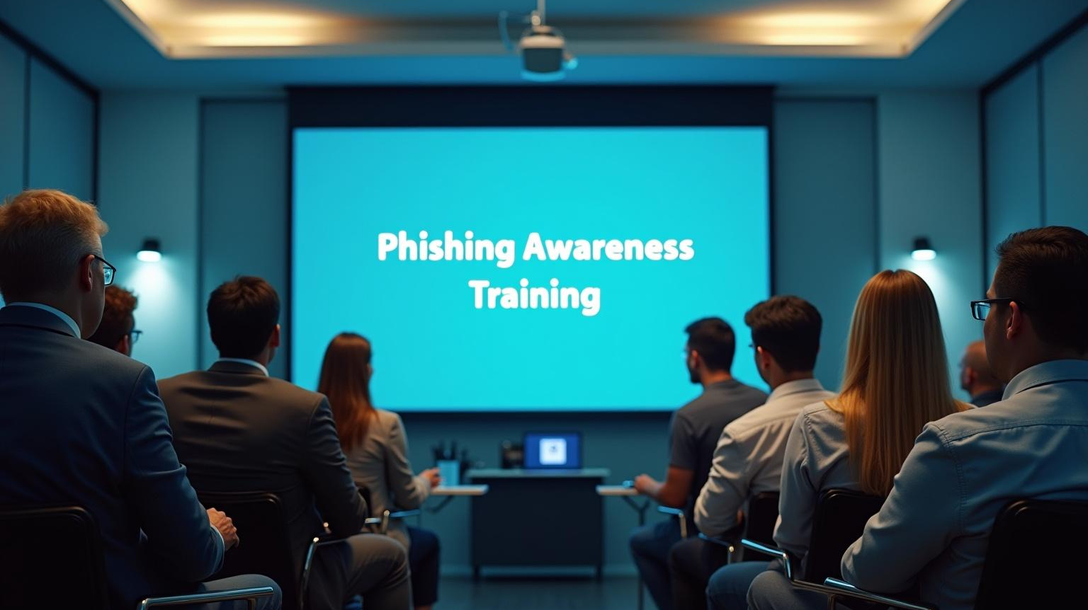
Phishing Awareness Training
Start here
Understanding, Identifying & Preventing Phishing Attacks

Slide 2
Introduction
Phishing is a critical threat in the digital landscape, where malicious actors attempt to deceive individuals into providing sensitive information. This presentation aims to shed light on phishing tactics, empower attendees to recognize these threats, and provide strategies for prevention and reporting. Awareness is key to defending against phishing attacks and safeguarding personal and organizational data.

Slide 3

Introduction to Phishing
01

Slide 4

Definition and Overview of Phishing
Phishing is a cybercrime where attackers impersonate legitimate entities to solicit sensitive information. This can include passwords, credit card numbers, and personal details, often through deceptive emails or messages.

Slide 5
Types of Phishing Attacks
Various phishing attacks exist, including spear phishing, which targets specific individuals, and whaling, which targets high-profile executives. Understanding these types helps in recognizing potential threats.

Slide 6
Importance of Phishing Awareness
Raising awareness about phishing is essential for both individuals and organizations. Knowledgeable employees are the first line of defense, reducing the risk of successful attacks and potential data breaches.

Slide 7
Identifying Phishing Attempts
02

Slide 8
Recognizing Red Flags
Phishing attempts often exhibit certain characteristics such as poor grammar, mismatched URLs, and urgent language requesting immediate action. Identifying these signs is crucial for prevention.

Slide 9
Analyzing Suspicious Emails
When receiving an unexpected email, analyze the sender's address, check for inconsistencies, and hover over links to reveal the true URLs. This scrutiny can prevent falling victim to phishing schemes.

Slide 10
Social Engineering Tactics Used
Social engineering is a manipulation technique utilized by attackers to deceive individuals into divulging confidential information. Techniques often include impersonation of trusted sources, urgency to prompt immediate action, and emotional triggers to create a sense of fear or excitement.

Slide 11

Preventing Phishing Attacks
03

Slide 12
Best Practices for Individuals
Individuals should remain vigilant by verifying the identity of senders, using two-factor authentication, and keeping software up to date. Educating themselves on the latest phishing tactics is also paramount in prevention efforts.

Slide 13
Organizational Policies and Training
Organizations should establish comprehensive phishing prevention policies, including regular training sessions for employees. Simulated phishing exercises can significantly enhance their ability to recognize and respond to real threats.

Slide 14
Tools and Technologies for Prevention
Implementing security measures such as email filters, anti-phishing software, and real-time threat intelligence can provide additional layers of defense against phishing attacks, helping to protect sensitive information from unauthorized access.

Slide 15
Reporting Phishing Incidents
04

Slide 16
Steps to Report Phishing Attempts
Reporting phishing incidents involves documenting the suspicious email or message, notifying IT or security teams, and forwarding the email to the appropriate governmental or organizational authorities. This helps in mitigating further risks.

Slide 17
Importance of Prompt Reporting
Timely reporting of phishing incidents is crucial in preventing further attacks and minimizing potential damage. It allows organizations to respond swiftly and reinforces a culture of vigilance and accountability among employees.

Slide 18

Building a Response Plan
Developing a robust incident response plan is essential. It should include procedures for identifying, containing, and recovering from phishing incidents, along with roles and responsibilities for all team members involved in the response process.

Slide 19

Conclusions
Phishing attacks represent a significant threat to cybersecurity. By understanding how these attacks operate, recognizing the tactics employed, and adhering to best practices for prevention, both individuals and organizations can substantially mitigate risks and enhance their security posture. Continuous education and prompt action are key to maintaining a strong defense against cyber threats.

Slide 20
Thank you!
Do you have any questions?
+00 000 000 000

